Slide 1
Welcome to
Math & Logic!

Slide 2
Review: What did we do in class last time?
Preview: What is the difference between Equal and Equivalent when dealing with Sets?
Notes:
Review: Test on Number Systems Applications
Preview: Same Elements vs. Same Number of Elements

Slide 3
Sets
Competency: Apply principles of set theory
Set Notation
Equal, Equivalent
Subsets
Venn Diagrams
Union, Intersection, Complement
Empty Set and Universe

Slide 4
Set Notation
One way to write a set is to list its elements.
A = {1, 2, 3}, B = {3, 2, 1}
Notes:
The order of the elements doesn’t matter; however, it is nice to put the elements in order if they can be ordered. In the slide above, sets A and B have the same elements.

Slide 5
Equal
Two sets are equal if and only if they contain the same elements.
A = {1, 2, 3}, B = {3, 2, 1}
These sets are equal.

Slide 6
Equivalent
Two sets are equivalent if and only if they contain the same number of elements.
A = {1, 3, 5}, B = {2, 4, 6}
These sets are equivalent.
Notes:
Can two sets be equivalent without being equal? Can two sets be equal without being equivalent?

Slide 7
Subset
The set A is a subset of set B if and only if every element of A is also in B.
A = {1, 3, 5}, B = {1, 2, 3, 4, 5, 6}
A⊆B
Notes:
Think of the subset symbol as a less-than-or-equal-to symbol.

Slide 8
Proper Subset
The set A is a proper subset of set B if and only if every element of A is also in B and A is not equal to B.
A = {1, 3, 5}, B = {1, 2, 3, 4, 5, 6}
A⊂B
Notes:
Think of the proper subset symbol as a strictly-less-than symbol.

Slide 9

Sets
Let’s practice now!
Notes:
Practice 1: Sets Solutions Solutions Video

Slide 10
Universal Set
U is the set of all items under consideration.

Slide 11
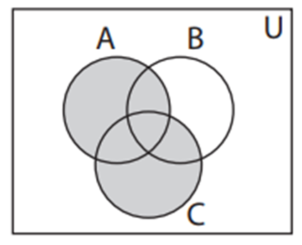
Union
The union of two sets is written A∪C.
To be in A∪C, an element must be in at least one of the sets.
Notes:
A U B is everything inside A together with everything inside B.
Notice the U in the upper right corner of the rectangle. The Universal Set is everything inside the rectangle. Since the symbol for Union looks a lot like the symbol for the Universal set, we must consider context.

Slide 12
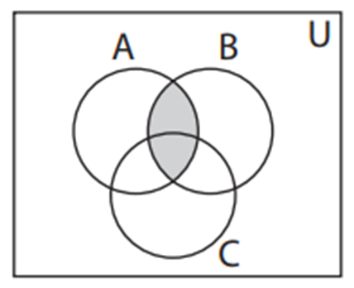
Intersection
The intersection of two sets is written A∩B.
To be in A∩B, an element must be in both sets.
Notes:
All elements in set A that are also in set B -- the overlap.

Slide 13
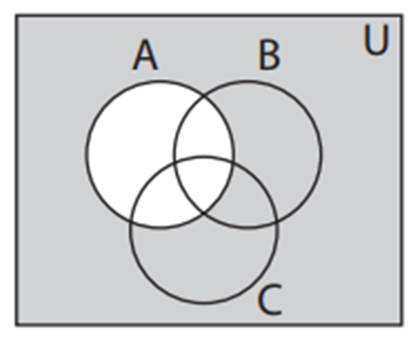
Complement
The complement of A is written A or A′ or A^{c}.
It is the set consisting of all elements in U that are outside of A.

Slide 14
Empty Set
The set consisting of no elements is called the empty set or null set.
{ } or Ø

Slide 15
Sets
Let’s practice now!
Notes:
Practice 2: Sets Solutions Solutions Video

Slide 16
Review
Set Notation
Equal, Equivalent
Subsets
Venn Diagrams
Union, Intersection, Complement
Empty Set and Universe

Slide 17
To Do:
Sets Quiz
Crash Course 17
Crash Course 18

Slide 18
Have a great day!
And remember that every day
at CVTC is a great day!

